Slide 1
AVR Microcontroller
Microprocessor Course
Chapter 7
AVR PROGRAMMING IN C
Esfand 1397 (Version 1.2)

Slide 2
AVR ADVANCED ASSEMBLY LANGUAGE PROGRAMMING 7.1 : DATA TYPES AND TIME DELAYS IN C
Why program the AVR in C?
Compilers produce hex files that we download into the Flash of the micro-controller. The size of the hex file produced by the compiler is one of the main concerns of microcontroller programmers because microcontrollers have limited on-chip Flash. For example, the Flash space for the Atmega16 is 16K bytes.
How does the choice of programming language affect the compiled program size? While Assembly language produces a hex file that is much smaller than C, programming in Assembly language is often tedious and time consuming. On the other hand, C programming is less time consuming and much easier to write, but the hex file size produced is much larger than if we used Assembly language.

Slide 3
AVR ADVANCED ASSEMBLY LANGUAGE PROGRAMMING 7.1 : DATA TYPES AND TIME DELAYS IN C
The following are some of the major reasons for writing programs in C instead of Assembly:
1. It is easier and less time consuming to write in C than in Assembly.
2. C is easier to modify and update.
3. You can use code available in function libraries.
4. C code is portable to other microcontrollers with little or no modification.

Slide 4
AVR ADVANCED ASSEMBLY LANGUAGE PROGRAMMING 7.1 : DATA TYPES AND TIME DELAYS IN C
Several third-party companies develop C compilers for the AVR microcontroller. Our goal is not to recommend one over another, but to provide you with the fundamentals of C programming for the AVR. You can use the compiler of your choice for the chapter examples and programs. For this book we have chosen AVR GCC compiler to integrate with AVR Studio. At the time of the writing of this book AVR GCC and AVR Studio are available as a free download from the Web. See http://www.MicroDigitalEd.com for tutorials on AVR Studio and the AVR GCC compiler.
C programming for the AVR is the main topic of this chapter. In Section
7.1 data types, and time delays
7.2 I/O programming
7.3 The logic operations AND, OR, XOR, inverter, and shift
7.4 ASCII and BCD conversions and checksums
7.5, data serialization for the AVR
7.6, memory allocation in C .

Slide 5
AVR ADVANCED ASSEMBLY LANGUAGE PROGRAMMING 7.1 : DATA TYPES AND TIME DELAYS IN C
In this section we first discuss C data types for the AVR and then provide code for time delay functions. C data types for the AVR C One of the goals of AVR programmers is to create smaller hex files, so it is worthwhile to re-examine C data types.
In other words, a good understanding of C data types for the AVR can help programmers to create smaller hex files. In this section we focus on the specific C data types that are most common and widely used in AVR C compilers.

Slide 6
AVR ADVANCED ASSEMBLY LANGUAGE PROGRAMMING 7.1 : DATA TYPES AND TIME DELAYS IN C
Table 7-1 shows data types and sizes, but these may vary from one compiler to another.

Slide 7
AVR ADVANCED ASSEMBLY LANGUAGE PROGRAMMING 7.1 : DATA TYPES AND TIME DELAYS IN C
Unsigned char
Because the AVR is an 8-bit microcontroller, the character data type is the most natural choice for many applications. The unsigned char is an 8-bit data type that takes a value in the range of 0-255 (00--FFH). It is one of the most widely used data types for the AVR. In many situations, such as setting a counter value, where there is no need for signed data, we should use the unsigned char instead of the signed char.
In declaring variables, we must pay careful attention to the size of the data and try to use unsigned char instead of int if possible. Because the AVR microcontroller has a limited number of registers and data RAM locations, using int in place of char can lead to the need for more memory space.

Slide 8
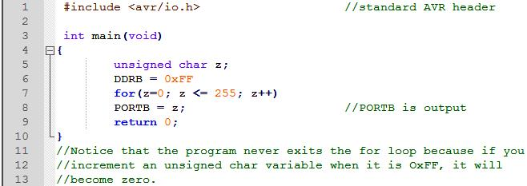
AVR ADVANCED ASSEMBLY LANGUAGE PROGRAMMING 7.1 : DATA TYPES AND TIME DELAYS IN C
Remember that C compilers use the signed char as the default unless we put the keyword unsigned in front of the char.
Example 7-1
Write an AVR C program to send values 00-FF to Port B.
Solution:

Slide 9
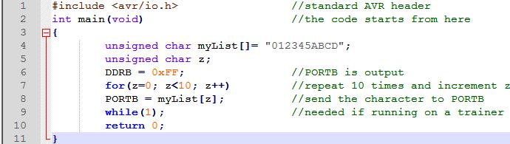
AVR ADVANCED ASSEMBLY LANGUAGE PROGRAMMING 7.1 : DATA TYPES AND TIME DELAYS IN C
Example 7-2
Write an AVR C program to send hex values for ASCII characters of 0, 1, 2, 3, 4, 5, A, B, C, and D to Port B.
Solution:

Slide 10
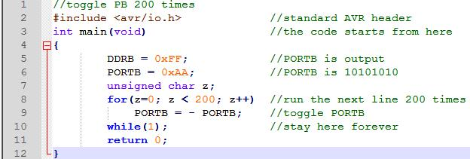
AVR ADVANCED ASSEMBLY LANGUAGE PROGRAMMING 7.1 : DATA TYPES AND TIME DELAYS IN C
Example 7-3
Write an AVR C program to toggle all the bits of PortB 200 times.
Solution:

Slide 11
AVR ADVANCED ASSEMBLY LANGUAGE PROGRAMMING 7.1 : DATA TYPES AND TIME DELAYS IN C
signed char
The signed char is an 8-bit data type that uses the most significant bit (D7 of D7-D0) to represent the - or + value. As a result, we have only 7 bits for the magnitude of the signed number, giving us values from -128 to +127.
In situations where + and - are needed to represent a given quantity such as temperature, the use of the signed char data type is necessary (see Example 7-4).
Again, notice that if we do not use the keyword unsigned, the default is the signed value. For that reason we should stick with the unsigned char unless the data needs to be represented as signed numbers.

Slide 12
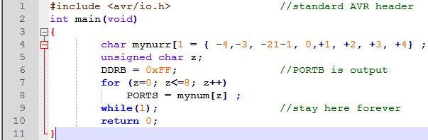
AVR ADVANCED ASSEMBLY LANGUAGE PROGRAMMING 7.1 : DATA TYPES AND TIME DELAYS IN C
Example 7-4
Write an AVR C program to send values of -4 to +4 to Port B.
Solution:
Run the above program on your simulator to see how PORTS displays values of FCH, FDH, FEH , FFH, 00H, 01H, 02H, 03H, and 04H (the hex values for -4, -3, -2, -1, 0, 1, etc.).

Slide 13
AVR ADVANCED ASSEMBLY LANGUAGE PROGRAMMING 7.1 : DATA TYPES AND TIME DELAYS IN C
Unsigned int
The unsigned int is a 16-bit data type that takes a value in the range of 0 to 65,535 (0000-FFFFH). In the AVR, unsigned int is used to define 16-bit variables such as memory addresses. It is also used to set counter values of more than 256. Because the AVR is an 8-bit microcontroller and the int data type takes two bytes of RAM, we must not use the int data type unless we have to.
Because registers and memory accesses are in 8-bit chunks, the misuse of int variables will result in
larger hex files,
slower execution of program, and
more memory usage.
For AVR programming, however, do not use signed int in places where unsigned char will do the job. Of course, the compiler will not generate an error for this misuse, but the overhead in hex file size will be noticeable.
Notes:
Such misuse is not a problem in PCs with 512 megabytes of memory, the 32-bit Pentium's registers and memory accesses, and a bus speed of 133 MHz.
Also, in situations where there is no need for signed data (such as setting counter values), we should use unsigned int instead of signed int. This gives a much wider range for data declaration. Again, remember that the C compiler uses signed int as the default unless we specify the keyword unsigned.

Slide 14
AVR ADVANCED ASSEMBLY LANGUAGE PROGRAMMING 7.1 : DATA TYPES AND TIME DELAYS IN C
Signed int
Signed int is a 16-bit data type that uses the most significant bit (D15 of D15-D0) to represent the - or + value. As a result, we have only 15 bits for the magnitude of the number, or values from -32,768 to +32,767.
Other data types
The unsigned int is limited to values 0-65,535 (0000-FFFFH). The AVR C compiler supports long data types, if we want values greater than 16-bit. Also, to deal with fractional numbers, most AVR C compilers support float and double data types.

Slide 15
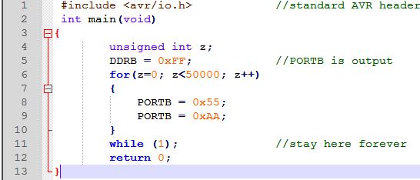
AVR ADVANCED ASSEMBLY LANGUAGE PROGRAMMING 7.1 : DATA TYPES AND TIME DELAYS IN C
Example 7-5
Write an AVR C program to toggle all bits of PortB 50,000 times.
Solution:
Run the above program on your simulator to see how Port B toggles continuously. Notice that the maximum value for unsigned int is 65,535.

Slide 16
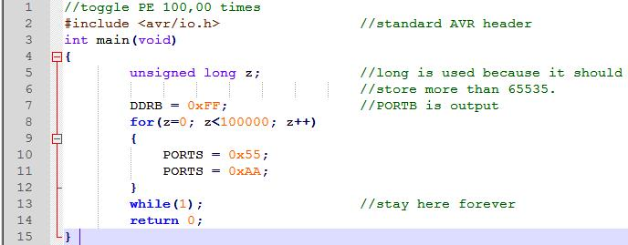
AVR ADVANCED ASSEMBLY LANGUAGE PROGRAMMING 7.1 : DATA TYPES AND TIME DELAYS IN C
Example 7-6
Write an AVR C program to toggle all bits of Port B 100,000 times.
Solution:

Slide 17
AVR ADVANCED ASSEMBLY LANGUAGE PROGRAMMING 7.1 : DATA TYPES AND TIME DELAYS IN C
Time delay
There are three ways to create a time delay in AVR C
Using a simple for loop
Using predefined C functions
Using AVR timers
In creating a time delay using a for loop, we must be mindful of two factors that can affect the accuracy of the delay:
The crystal frequency connected to the XTAL1-XTAL2 input pins is the most important factor in the time delay calculation. The duration of the clock period for the instruction cycle is a function of this crystal frequency.
The second factor that affects the time delay is the compiler used to compile the C program. When we program in Assembly language, we can control the exact instructions and their sequences used in the delay subroutine. In the case of C programs, it is the C compiler that converts the C statements and functions to Assembly language instructions. As a result, different compilers pro-duce different code.

Slide 18
AVR ADVANCED ASSEMBLY LANGUAGE PROGRAMMING 7.1 : DATA TYPES AND TIME DELAYS IN C
For the above reasons, when we use a loop to write time delays for C, we must use the oscilloscope to measure the exact duration. Notice that most compilers do some code optimization before generating a .hex file. In these compilers, you have to set the level of optimization to zero (none).

Slide 19
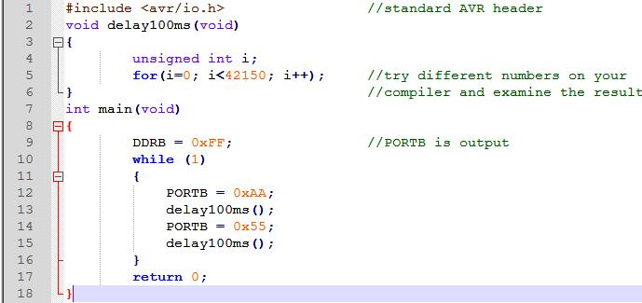
AVR ADVANCED ASSEMBLY LANGUAGE PROGRAMMING 7.1 : DATA TYPES AND TIME DELAYS IN C
Example 7-7
Write an AVR C program to toggle all the bits of Port B continuously with a 100 ms delay. Assume that the system is ATmega 32 with XTAL = 8 MHz.
Solution:

Slide 20
AVR ADVANCED ASSEMBLY LANGUAGE PROGRAMMING 7.1 : DATA TYPES AND TIME DELAYS IN C
Mother way of generating time delay is to use predefined functions such as _delay_ms() and _delay_us() defined in delay.h in WinAVR or delay_ms() and delay_us() defined in delay.h in CodeVision.
The only drawback of using these functions is the portability problem. Because different compilers do not use the same name for delay functions, you have to change every place in which the delay functions are used, if you want to compile your program on another compiler.
The use of the AVR timer to create time delays will be discussed in Chapter 9.

Slide 21
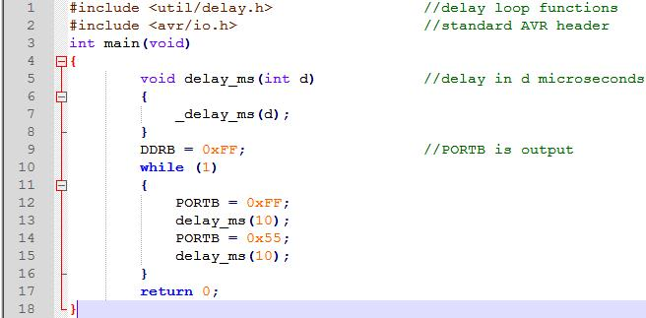
AVR ADVANCED ASSEMBLY LANGUAGE PROGRAMMING 7.1 : DATA TYPES AND TIME DELAYS IN C
Example 7-8
Write an AVR C program to toggle all the pins of Port C continuously with a 10 ms delay. Use a predefined delay function in Win AVR.
Solution:

Slide 22
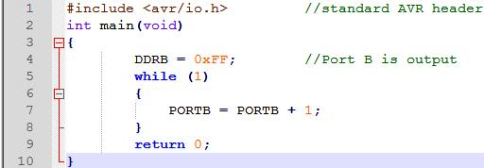
AVR ADVANCED ASSEMBLY LANGUAGE PROGRAMMING 7.2 : I/O PROGRAMMING IN C
Byte size I/O
To access a PORT register as a byte, we use the PORTx label where x indicates the name of the port. We access the data direction registers in the same way, using DDRx to indicate the data direction of port x. To access a PIN register as a byte, we use the PINx label where x indicates the name of the port.
Example 7-9
LEDs are connected to pins of Port B. Write an AVR C program that shows the count from 0 to FFH (0000 0000 to 1111 1111 in binary) on the LEDs.
Solution:

Slide 23
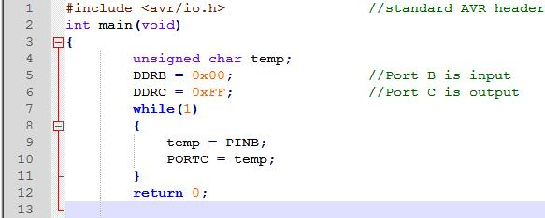
AVR ADVANCED ASSEMBLY LANGUAGE PROGRAMMING 7.2 : I/O PROGRAMMING IN C
Example 7-10
Write an AVR C program to get a byte of data from Port B, and then send it to Port C.
Solution:

Slide 24
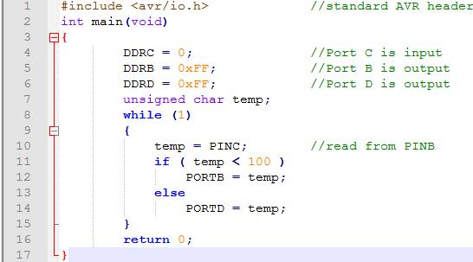
AVR ADVANCED ASSEMBLY LANGUAGE PROGRAMMING 7.2 : I/O PROGRAMMING IN C
Example 7-11
Write an AVR C program to get a byte of data from Port C. If it is less than 100, send it to Port B; otherwise, send it to Port D.
Solution:

Slide 25
AVR ADVANCED ASSEMBLY LANGUAGE PROGRAMMING 7.2 : I/O PROGRAMMING IN C
Bit size I/O
The I/O ports of ATmega32 are bit-accessible. But some AVR C compilers do not support this feature, and the others do not have a standard way of using it. For example, the following line of code can be used in CodeVision to set the first pin of Port B to one:
PORTE.0 = 1;
but it cannot be used in other compilers such as WinAVR. To write portable code that can be compiled on different compilers, we must use AND and OR bit-wise operations to access a single bit of a given register.
So, you can access a single bit without disturbing the rest of the byte.

Slide 26
AVR ADVANCED ASSEMBLY LANGUAGE PROGRAMMING 7.3 : LOGIC OPERATIONS IN C
Bit-wise operators in C
While every C programmer is familiar with the logical operators AND (&&), OR (||), and NOT (!), many C programmers are less familiar with the bit-wise operators AND (&) OR (|), EX-OR (^), inverter (~), shift right (>>), and shift left (<<). These bit-wise operators are widely used in software engineering for embedded systems and control; consequently, their understanding and mastery are critical in microcontroller-based system design and interfacing.

Slide 27
AVR ADVANCED ASSEMBLY LANGUAGE PROGRAMMING 7.3 : LOGIC OPERATIONS IN C
Unsigned char

Slide 28
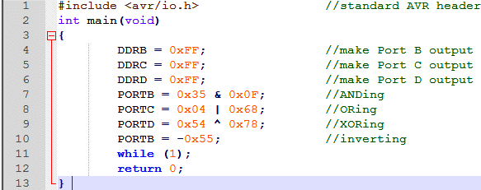
AVR ADVANCED ASSEMBLY LANGUAGE PROGRAMMING 7.2 : I/O PROGRAMMING IN C
Example 7-12
Run the following program on your simulator and examine the results.

Slide 29
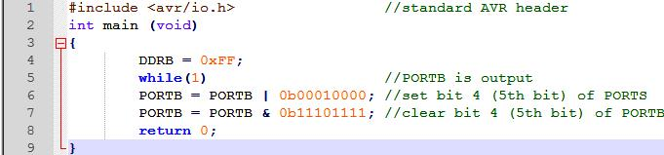
AVR ADVANCED ASSEMBLY LANGUAGE PROGRAMMING 7.3 : LOGIC OPERATIONS IN C
Example 7-13
Write an AVR C program to toggle only bit 4 of Port B continuously without disturbing the rest of the pins of Port B.
Solution:

Slide 30
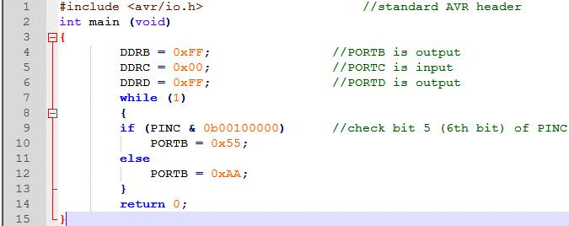
AVR ADVANCED ASSEMBLY LANGUAGE PROGRAMMING 7.3 : LOGIC OPERATIONS IN C
Example 7-14
Write an AVR C program to monitor bit 5 of port C. If it is HIGH, send 55H to Port B; otherwise, send AAH to Port B.
Solution:

Slide 31
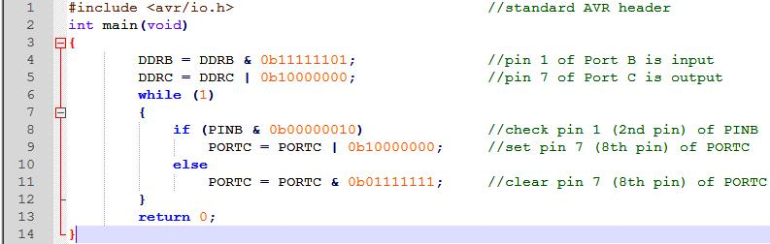
AVR ADVANCED ASSEMBLY LANGUAGE PROGRAMMING 7.3 : LOGIC OPERATIONS IN C
Example 7-15
A door sensor is connected to bit 1 of Port B, and an LED is connected to bit 7 of Port C. Write an AVR C program to monitor the door sensor and, when it opens, turn on the LED.
Solution:

Slide 32
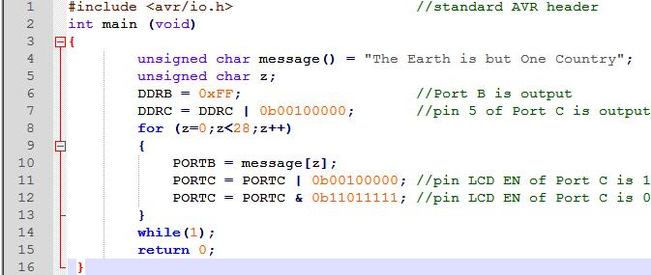
AVR ADVANCED ASSEMBLY LANGUAGE PROGRAMMING 7.3 : LOGIC OPERATIONS IN C
Example 7-16
The data pins of an LCD are connected to Port B. The information is latched into the LCD whenever its Enable pin goes from HIGH to LOW. The enable pin is connected to pin 5 of Port C (6th pin). Write a C program to send "The Earth is but One Country" to this LCD.
Solution:

Slide 33
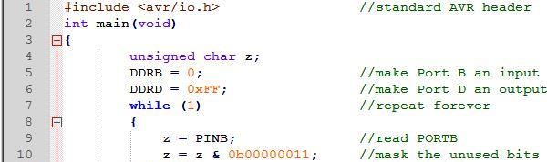
AVR ADVANCED ASSEMBLY LANGUAGE PROGRAMMING 7.3 : LOGIC OPERATIONS IN C
Example 7-17
Write an AVR C program to read pins 1 and 0 of Port B and issue an ASCII character to Port D according to the following table:
pin1 pin0
0 0 send '0' to Port D (notice ASCII '0' is 0x30)
0 1 send '1' to Port D
1 0 send '2' to Port D
1 1 send '3' to Port D
Solution:

Slide 34
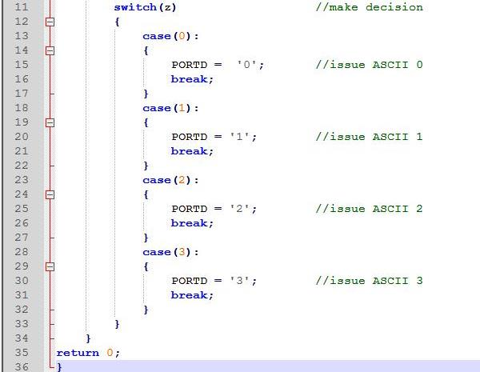
AVR ADVANCED ASSEMBLY LANGUAGE PROGRAMMING 7.3 : LOGIC OPERATIONS IN C
Unsigned char

Slide 35
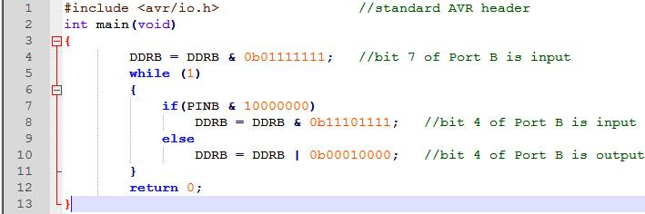
AVR ADVANCED ASSEMBLY LANGUAGE PROGRAMMING 7.3 : LOGIC OPERATIONS IN C
Example 7-18
Write an AVR C program to monitor bit 7 of Port B. If it is 1, make bit 4 of Port B input; otherwise, change pin 4 of Port B to output.
Solution:

Slide 36
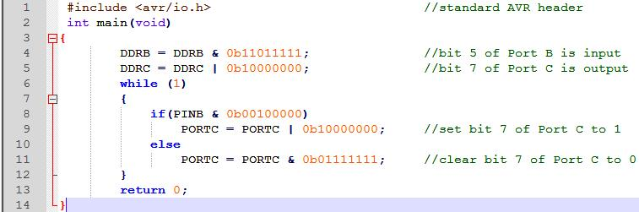
AVR ADVANCED ASSEMBLY LANGUAGE PROGRAMMING 7.3 : LOGIC OPERATIONS IN C
Example 7-19
Write an AVR C program to get the status of bit 5 of Port B and send it to bit 7 of port C continuously.
Solution:

Slide 37
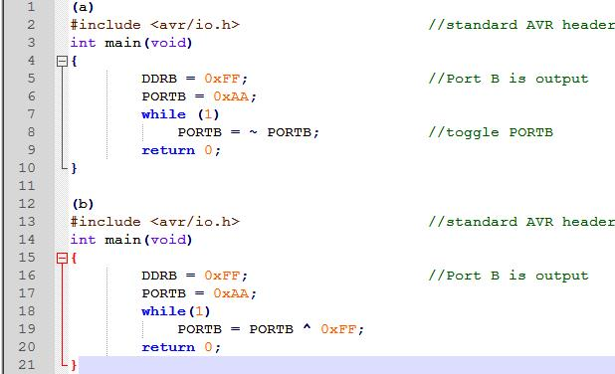
AVR ADVANCED ASSEMBLY LANGUAGE PROGRAMMING 7.3 : LOGIC OPERATIONS IN C
Example 7-20
Write an AVR C program to toggle all the pins of Port B continuously.
(a) Use the inverting operator. (b) Use the EX-OR operator.
Solution:

Slide 38
AVR ADVANCED ASSEMBLY LANGUAGE PROGRAMMING 7.3 : LOGIC OPERATIONS IN C
Unsigned char

Slide 39
AVR ADVANCED ASSEMBLY LANGUAGE PROGRAMMING 7.3 : LOGIC OPERATIONS IN C
Unsigned char

Slide 40
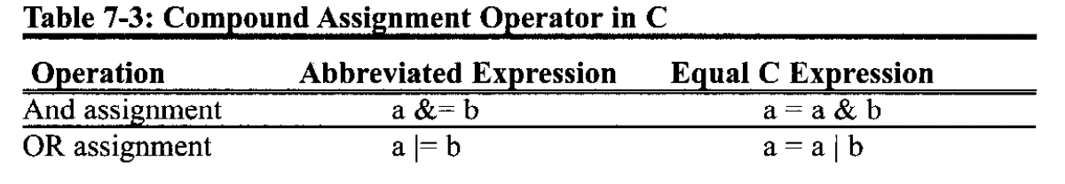
AVR ADVANCED ASSEMBLY LANGUAGE PROGRAMMING 7.3 : LOGIC OPERATIONS IN C
Compound assignment operator in C
To reduce coding (typing) we can use compound statements for bit-wise operators in C.

Slide 41
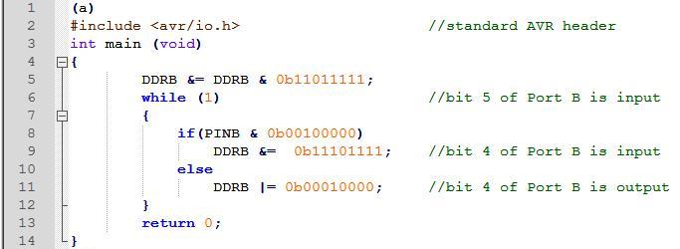
AVR ADVANCED ASSEMBLY LANGUAGE PROGRAMMING 7.3 : LOGIC OPERATIONS IN C
Example 7-21
Using bitwise compound assignment operators
(a) Rewrite Example 7-18 (b) Rewrite Example 7-19
Solution:

Slide 42
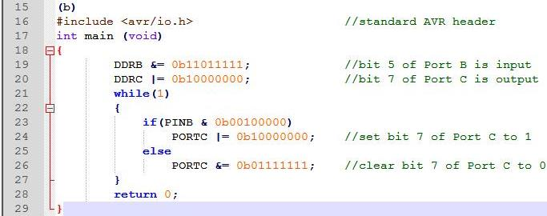
AVR ADVANCED ASSEMBLY LANGUAGE PROGRAMMING 7.3 : LOGIC OPERATIONS IN C
Unsigned char

Slide 43
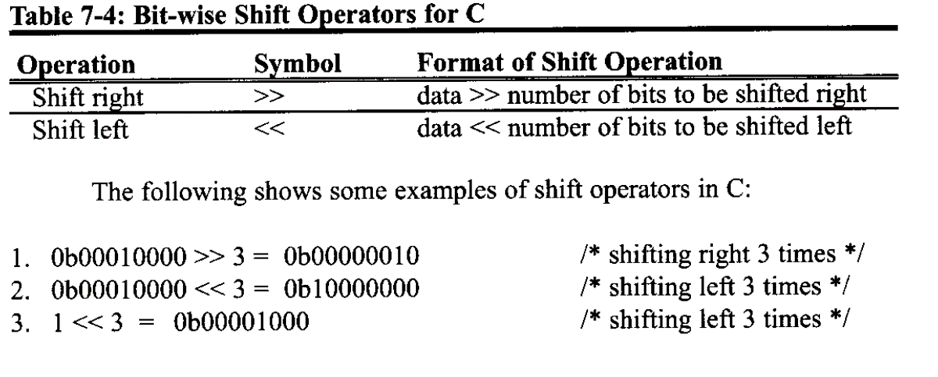
AVR ADVANCED ASSEMBLY LANGUAGE PROGRAMMING 7.3 : LOGIC OPERATIONS IN C
Bit-wise shift operation in C
There are two bit-wise operator in C

Slide 44
AVR ADVANCED ASSEMBLY LANGUAGE PROGRAMMING 7.3 : LOGIC OPERATIONS IN C
Bit-wise shift operation and bit manipulation
Reexamine the last 10 examples. To do bit-wise I/O operation in C, we need numbers like 0b00100000 in which there are seven zeroes and one one. Only the position of the one varies in different programs. To leave the generation of ones and zeros to the compiler and improve the code clarity, we use shift operations. For example, instead of writing “0b00100000" we can write “0b00000001 << 5" or we can write simply "1<<5".
Sometimes we need numbers like 0b11101111. To generate such a number, we do the shifting first and then invert it. For example, to generate 0b11101111 we can write ~ (1<<5).

Slide 45
AVR ADVANCED ASSEMBLY LANGUAGE PROGRAMMING 7.3 : LOGIC OPERATIONS IN C
Unsigned char

Slide 46
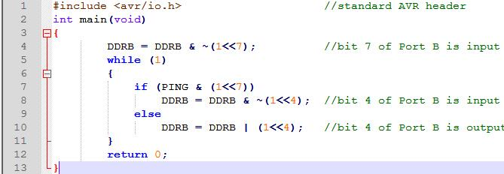
AVR ADVANCED ASSEMBLY LANGUAGE PROGRAMMING 7.3 : LOGIC OPERATIONS IN C
Example 7-23
Write an AVR C program to monitor bit 7 of Port B. If it is 1, make bit 4 of Port B input; else, change pin 4 of Port B to output.
Solution:

Slide 47
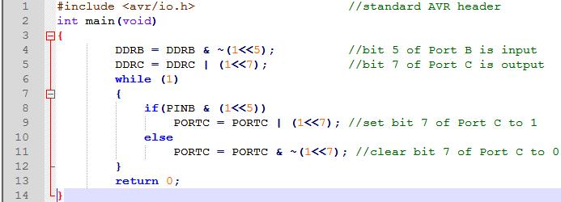
AVR ADVANCED ASSEMBLY LANGUAGE PROGRAMMING 7.3 : LOGIC OPERATIONS IN C
Example 7-24
Write an AVR C program to get the status of bit 5 of Port B and send it to bit 7 of port C continuously.
Solution:

Slide 48
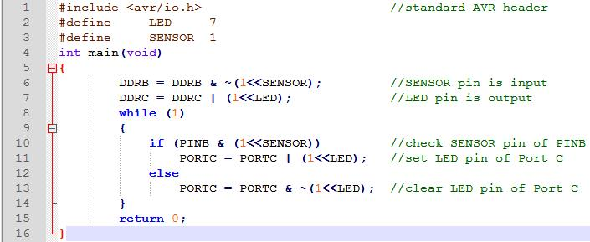
AVR ADVANCED ASSEMBLY LANGUAGE PROGRAMMING 7.3 : LOGIC OPERATIONS IN C
As we mentioned before, bit-wise shift operation can be used to increase code clarity.
Example 7-25
A door sensor is connected to the port B pin 1, and an LED is connected to port C pin 7. Write an AVR C program to monitor the door sensor and, when it opens, turn on the LED.
Solution:

Slide 49
AVR ADVANCED ASSEMBLY LANGUAGE PROGRAMMING 7.3 : LOGIC OPERATIONS IN C
Notice that to generate more complicated numbers, we can OR two simpler numbers. For example, to generate a number that has a one in position D7 and another one in position D4, we can OR a number that has only a one in position D7 with a number that has only a one in position D4. So we can simply write (1<<7)|(1<<4).

Slide 50
AVR ADVANCED ASSEMBLY LANGUAGE PROGRAMMING 7.4 : DATA CONVERSION PROGRAMS IN C
ASCII numbers
On ASCII keyboards, when the "0" key is activated, "0011 0000" (30H) is provided to the computer. Similarly, 31 H (0011 0001) is provided for the "1" key, and so on.
Notes:
Recall that BCD numbers were discussed in Chapters 5 and 6. As stated there, many newer microcontrollers have a real-time clock (RTC) where the time and date are kept even when the power is off. Very often the RTC provides the time and date in packed BCD. To display them, however, we must convert them to ASCII. In this section we show the application of logic and rotate instructions in the conversion of BCD and ASCII.

Slide 51
AVR ADVANCED ASSEMBLY LANGUAGE PROGRAMMING 7.4 : DATA CONVERSION PROGRAMS IN C
Packed BCD to ASCII conversion
The RTC provides the time of day (hour, minute, second) and the date (year, month, day) continuously, regardless of whether the power is on or off. This data is provided in packed BCD. To convert packed BCD to ASCII, you must first convert it to unpacked BCD. Then the unpacked BCD is tagged with 011 0000 (30H). The following demonstrates converting from packed BCD to ASCII. See also Example 7-26.
Packed BCD | Unpacked BCD | ASCII
0x29 | 0x02, 0x09 | 0x32, 0x39
00101001 | 00000010, 00001001 | 00110010, 00111001

Slide 52
AVR ADVANCED ASSEMBLY LANGUAGE PROGRAMMING 7.4 : DATA CONVERSION PROGRAMS IN C
ASCII to packed BCD conversion
To convert ASCII to packed BCD, you first convert it to unpacked BCD (to get rid of the 3), and then combine the numbers to make packed BCD. For example, 4 and 7 on the keyboard give 34H and 37H, respectively. The goal is to produce 47H or "0100 0111", which is packed BCD.
Key | ASCII | Unpacked BCD | Packed BCD
4 | 34 | 00000100
7 | 37 | 00000111 | 01000111 or 47H

Slide 53
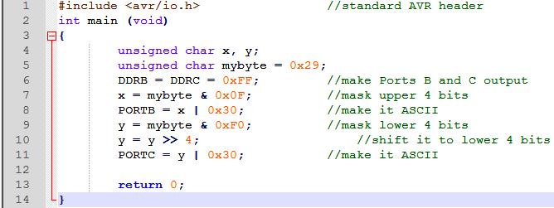
AVR ADVANCED ASSEMBLY LANGUAGE PROGRAMMING 7.4 : DATA CONVERSION PROGRAMS IN C
Example 7-26
Write an AVR C program to convert packed BCD 0x29 to ASCII and display the bytes on PORTB and PORTC.
Solution:

Slide 54
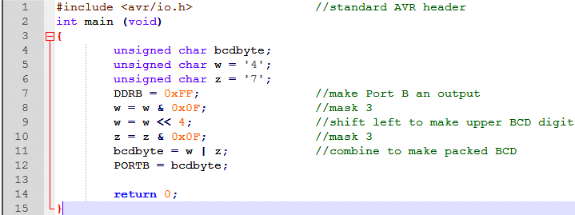
AVR ADVANCED ASSEMBLY LANGUAGE PROGRAMMING 7.4 : DATA CONVERSION PROGRAMS IN C
Example 7-27
Write an AVR C program to convert ASCII digits of '4' and '7' to packed BCD and display them on PORTB.
Solution:

Slide 55
AVR ADVANCED ASSEMBLY LANGUAGE PROGRAMMING 7.4 : DATA CONVERSION PROGRAMS IN C
Checksum byte in ROM
To ensure data integrity, the checksum process uses what is called a checksum byte. The checksum byte is an extra byte that is tagged to the end of a series of bytes of data. To calculate the checksum byte of a series of bytes of data, the following steps can be taken:
Add the bytes together and drop the carries.
Take the 2's complement of the total sum.
This is the checksum byte, which becomes the last byte of the series.
To perform the checksum operation, add all the bytes, including the check-sum byte. The result must be zero. If it is not zero, one or more bytes of data have been changed (corrupted).
Notes:
To ensure the integrity of data, every system must perform the checksum calculation. When you transmit data from one device to another or when you save and restore data to a storage device you should perform the checksum calculation to ensure the integrity of the data. The checksum will detect any corruption of data.

Slide 56
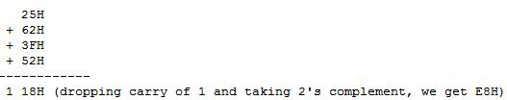
AVR ADVANCED ASSEMBLY LANGUAGE PROGRAMMING 7.4 : DATA CONVERSION PROGRAMS IN C
Example 7-28
Assume that we have 4 bytes of hexadecimal data: 25H, 62H, 3FH, and 52H. (a) Find the checksum byte,
(b) perform the checksum operation to ensure data integrity, and
(c) if the second byte, 62H, has been changed to 22H, show how check-sum detects the error.
Solution:
Find the checksum byte.

Slide 57
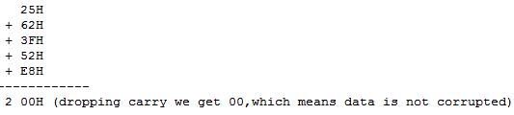
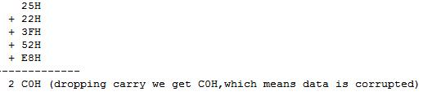
AVR ADVANCED ASSEMBLY LANGUAGE PROGRAMMING 7.4 : DATA CONVERSION PROGRAMS IN C
(b) Perform the checksum operation to ensure data integrity.
(c) If the second byte, 62H has been changed to 22H show how checksum detects the error.

Slide 58
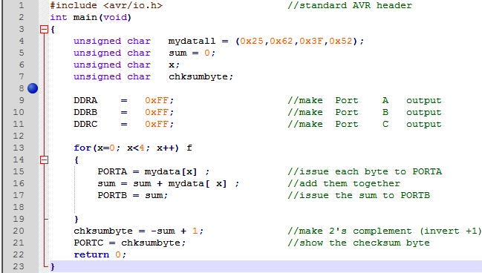
AVR ADVANCED ASSEMBLY LANGUAGE PROGRAMMING 7.4 : DATA CONVERSION PROGRAMS IN C
Example 7-29
Write an AVR C program to calculate the checksum byte for the data given in Example 7-28.
Solution:

Slide 59
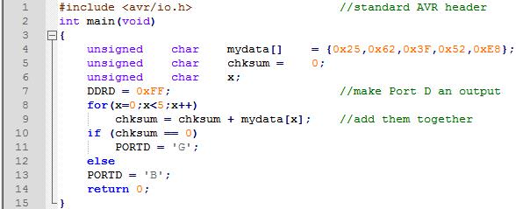
AVR ADVANCED ASSEMBLY LANGUAGE PROGRAMMING 7.4 : DATA CONVERSION PROGRAMS IN C
Example 7-30
Write a C program to perform step (b) of Example 7-28. If the data is good, send ASCII character `G.' to PORTD. Otherwise, send '13' to PORTD.
Solution:
Change one or two values in the mydata array and simulate the program to see the results.

Slide 60
AVR ADVANCED ASSEMBLY LANGUAGE PROGRAMMING 7.4 : DATA CONVERSION PROGRAMS IN C
Binary (hex) to decimal and ASCII conversion in C
The printf function is part of the standard I/O library in C and can do many things including converting data from binary (hex) to decimal, or vice versa. But printf takes a lot of memory space and increases your hex file substantially. For this reason, in systems based on the AVR microcontroller, it is better to know how to write our own conversion function instead of using printf.
One of the most widely used conversions is binary to decimal conversion. In devices such as ADCs (Analog-to-Digital Converters), the data is provided to the microcontroller in binary. In some RTCs, the time and dates are also provided in binary.

Slide 61
AVR ADVANCED ASSEMBLY LANGUAGE PROGRAMMING 7.4 : DATA CONVERSION PROGRAMS IN C
In order to display binary data, we need to convert it to decimal and then to ASCII. Because the hexadecimal format is a convenient way of representing binary data, we refer to the binary data as hex. The binary data 00-FFH converted to decimal will give us 000 to 255. One way to do that is to divide it by 10 and keep the remainder, as was shown in Chapters 5 and 6. For example, 11111101 or FDH is 253 in decimal. The following is one version of an algorithm for conversion of hex (binary) to decimal:
Hex | Quotient | Remainder
FD/0A | 19 | 3 (low digit) LSD
19/0A | 2 | 5 (middle digit)
 |  | 2 (high digit) MSD

Slide 62
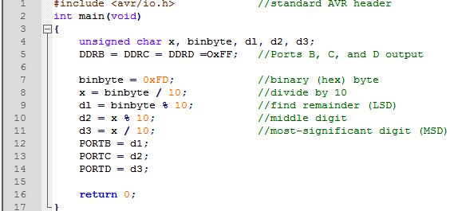
AVR ADVANCED ASSEMBLY LANGUAGE PROGRAMMING 7.4 : DATA CONVERSION PROGRAMS IN C
Example 7-31
Write an AVR C program to convert 11111101 (FD hex) to decimal and display the dig-its on PORTB, PORTC, and PORTD.
Solution:

Slide 63
AVR ADVANCED ASSEMBLY LANGUAGE PROGRAMMING 7.4 : DATA CONVERSION PROGRAMS IN C
Many compilers have some predefined functions to convert data types. In Table 7-6 you can see some of them. To use these functions, the stdlib.h file should be included. Notice that these functions may vary in different compilers.

Slide 64
AVR ADVANCED ASSEMBLY LANGUAGE PROGRAMMING 7.5 : DATA SERIALIZATION IN C
Serializing data is a way of sending a byte of data one bit at a time through a single pin of a microcontroller. There are two ways to transfer a byte of data serially:
Using the serial port. In using the serial port, the programmer has very limited control over the sequence of data transfer. The details of serial port data transfer are discussed in Chapter 11.
The second method of serializing data is to transfer data one bit a time and control the sequence of data and spaces between them. In many new generations of devices such as LCD, ADC, and EEPROM, the serial versions are becoming popular because they take up less space on a printed circuit board. Although we can use standards such as PC, SPI, and CAN, not all devices support such standards. For this reason we need to be familiar with data serialization using the C language.

Slide 65
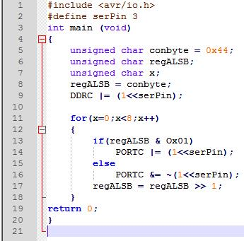
AVR ADVANCED ASSEMBLY LANGUAGE PROGRAMMING 7.5 : DATA SERIALIZATION IN C
Example 7-32
Write an AVR C program to send out the value 44H serially one bit at a time via PORTC, pin 3. The LSB should go out first.
Solution:

Slide 66
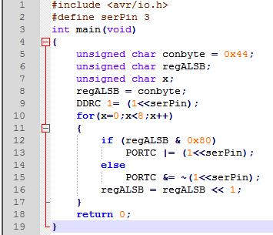
AVR ADVANCED ASSEMBLY LANGUAGE PROGRAMMING 7.5 : DATA SERIALIZATION IN C
Example 7-33
Write an AVR C program to send out the value 44H serially one bit at a time via PORTC, pin 3. The MSB should go out first.
Solution:

Slide 67
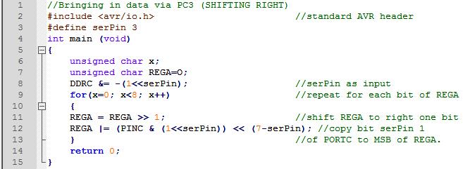
AVR ADVANCED ASSEMBLY LANGUAGE PROGRAMMING 7.5 : DATA SERIALIZATION IN C
Example 7-34
Write an AVR C program to bring in a byte of data serially one bit at a time via PORTC, pin 3. The LSB should come in first.
Solution:

Slide 68
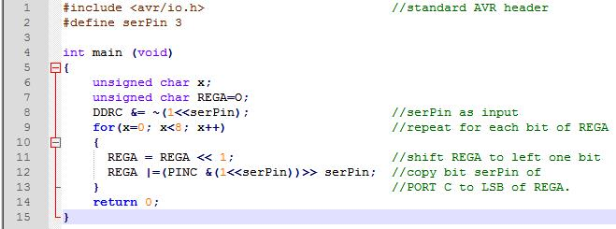
AVR ADVANCED ASSEMBLY LANGUAGE PROGRAMMING 7.5 : DATA SERIALIZATION IN C
Example 7-35
Write an AVR C program to bring in a byte of data serially one bit at a time via PORTC, pin 3. The MSB should come in first.
Solution:

Slide 69
AVR ADVANCED ASSEMBLY LANGUAGE PROGRAMMING 7.6 : MEMORY ALLOCATION IN C
Memory Allocation in C
Using program (code) space for predefined fixed data is a widely used option in the AVR, as we saw in Chapter 6. In that chapter we saw how to use Assembly language programs to access the data stored in ROM. Next, we do the same thing with C language.
Flash, RAM, and EEPROM data space in the AVR
In the AVR we have three spaces in which to store data. They are as follows:

Slide 70
AVR ADVANCED ASSEMBLY LANGUAGE PROGRAMMING 7.6 : MEMORY ALLOCATION IN C
The 64K bytes of SRAM space with address range 0000-FFFFH. We also have seen how we can read (from) or write (into) this RAM space directly or indirectly. We store temporary variables in SRAM since the SRAM is the scratch pad.
The 2M words (4M bytes) of code (program) space with addresses of 000000-1FFFFFH. This 2M words of on-chip Flash ROM space is used primarily for storing programs (opcodes) and therefore is directly under control of the program counter (PC).
EEPROM. As we mentioned before, EEPROM can save data when the power is off. That is why we use EEPROM to save variables that should not be lost when the power is off. For example, the temperature set point of a cooling system should be changed by users and cannot be stored in program space.

Slide 71
AVR ADVANCED ASSEMBLY LANGUAGE PROGRAMMING 7.6 : MEMORY ALLOCATION IN C
In Chapter 6 we saw how to read from or write to EEPROM. In this chapter we will show the same concept using C programming. Notice that different C compilers may have their built-in functions or directives to access each type of memory.
In CodeVision, to define a const variable in the Flash memory, you only need to put the Flash directive before it. Also, to define a variable in EEPROM, you can put the eeprom directive in front of it:
flash unsigned char mynurr[] = "Hello"; //use Flash code space
eeprom unsigned char = 7 //use EEPROM space
To learn how you can use the built-in functions or directives of your compiler, you should consult the manual for your compiler. Also, you can download some examples using different compilers from www.MicroDigitalEd.com.

Slide 72
AVR ADVANCED ASSEMBLY LANGUAGE PROGRAMMING 7.6 : MEMORY ALLOCATION IN C
EEPROM access in C
In Chapter 6 we saw how we can access EEPROM using Assembly language. Next, we do the same thing with C language. Notice that as we mentioned before, most compilers have some built-in functions or directives to make the job of accessing the EEPROM memory easier. See Examples 7-36 and 7-37 to learn how we access EEPROM in C.

Slide 73
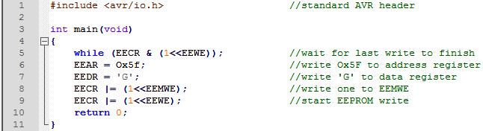
AVR ADVANCED ASSEMBLY LANGUAGE PROGRAMMING 7.6 : MEMORY ALLOCATION IN C
Example 7-36
Write an AVR C program to store 'G' into location Ox005F of EEPROM.
Solution:

Slide 74
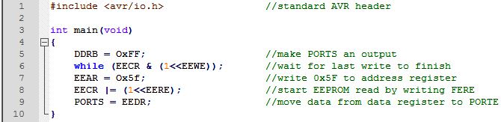
AVR ADVANCED ASSEMBLY LANGUAGE PROGRAMMING 7.6 : MEMORY ALLOCATION IN C
Example 7-37
Write an AVR C program to read the content of location 0x005F of EEPROM into PORTB.
Solution:

